Slide 1


CSET211: Statistical Machine Learning
AI-Based Real-Time Yoga Pose Detection
and Correction System
Team Members:
Harshit Gaur- S24CSEU2794
Rajat Sahay- S24CSEU2775
Lovenish Kharb- S24CSEU2788

Slide 2

Problem Statement
Many people practice yoga at home but do not have guidance to check:
Whether their posture is correct
If their body alignment is accurate
How close they are to performing the pose correctly
Whether they are improving over time
Incorrect yoga postures can lead to injuries, muscle strain, and ineffective practice.
There is a need for a real-time, accessible AI-based Yoga Coach that can guide users, correct mistakes, and improve their fitness safely.

Slide 3
PROPOSED SOLUTION
We developed an AI-based Yoga Pose Detection System that:
Uses MoveNet (Google) to detect 17 body keypoints from a live image/video
Trains a custom neural network to classify yoga poses
Gives feedback on whether the pose is correct
Works through a simple web interface
Runs completely on device using TensorFlow.js, enabling real-time corrections
This system acts like a virtual yoga trainer that helps users practice anytime, anywhere.

Slide 4




GOALS AND OBJECTIVES
E Help Users Improve Yoga Posture
Using AI pose detection, the system guides users to perform yoga poses correctly, reducing the risk of injuries and improving posture accuracy.
Build an AI Model Using Keypoint Data
Modernize Traditional Yoga with Technology
From a developer’s perspective, this project helps us understand pose estimation, preprocessing keypoints, and training neural networks for classification.
.
Combine ancient yoga principles with modern AI to make learning yoga more appealing to tech-savvy users..

Slide 5


TECHNOLOGY USED
Machine Learning & AI
MoveNet Pose Estimation: Real-time body keypoint tracking for accurate yoga posture detection
TensorFlow & Keras: Deep learning frameworks powering the pose analysis model
Scikit-learn: Feature processing and evaluation tools used during experimentation
Backend & Processing
Python: Core programming language for model execution and backend logic
FastAPI / Flask: Lightweight REST API enabling smooth communication between model & UI
Real-time Inference Engine: Processes live video frames to deliver instant pose feedback
Data & Infrastructure
Yoga Pose Dataset: Collection of curated pose images used for training
OpenCV: Image acquisition, processing, and frame extraction from webcam
Local/Cloud Deployment: Flexible execution environment for testing and demonstration
User Interface
HTML, CSS, JavaScript: Interactive and responsive frontend design
TensorFlow.js: Enables in-browser pose detection for fast, device-friendly usage
Mobile-First Design: Ensures smooth access across smartphones, tablets, and desktops

Slide 6
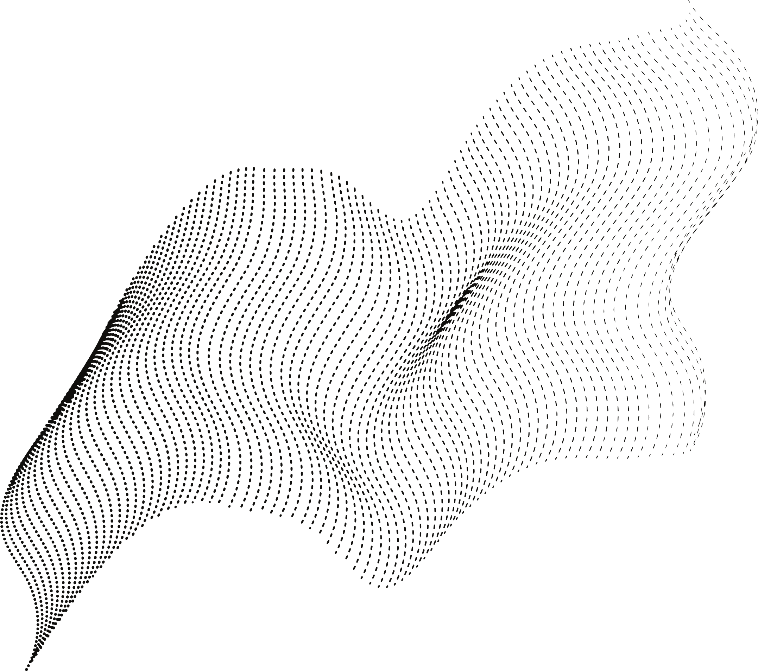
Pose Detection:
Detects user’s body posture using MoveNet ML model.
Accuracy Score:
Displays percentage accuracy for each detected pose.
Low Latency Processing:
Prediction occurs within milliseconds for smooth feedback.
User-Friendly UI:
Minimal and clean interface for easy use.
KEY FEATURES
Camera-Based Tracking:
Works using any webcam or laptop camera.
Frame-by-Frame Analysis:
Evaluates pose on every frame for consistent tracking.
.

Slide 7
Future Prospect
More Yoga Poses
Expand from 8 poses to 20+ advanced yoga postures
Performance History
Track progress over days, weeks, and months.
Posture Correction Suggestions
Highlight specific incorrect joints and how to fix them.
Personalized Yoga Plans
Generate custom daily routines based on user skill level.
Gamification
Add streaks, rewards, and levels to increase motivation.

Slide 8
Thank You!

